Slide 1


Department of Mechanical Engineering
Mini Project
On
Experimental investigation and numerical analysis of composite sandwich panels subjected to variable loading
Presented by
M N Sanath | 1NH18ME062
Nihal C L | 1NH18ME078
Prabhuling | 1NH18ME087
Shivaprasad P M | 1NH18ME103
Guided by
Mr. Rajesh
Professor, Dept. of ME, NHCE

Slide 2
Contents
What is Composite?
Reinforcements
Core
Adhesive Components
Sandwich Panels
Material Selection
Material Analysis
Fabrication
TPU material
Why Hexagon is used?
Tests

Slide 3
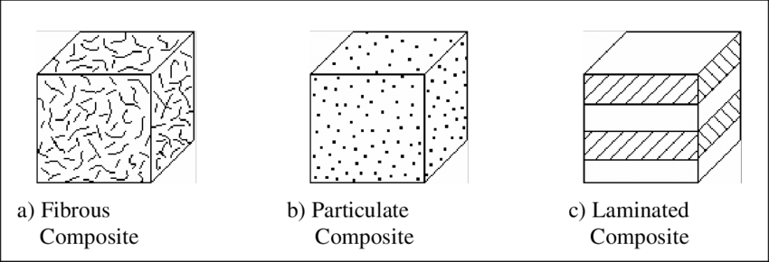
What is Composite?
A composite is a structural material that consists of two or more combined constituents that are combined at a macroscopic level and are not soluble in each other. One constituent is called the reinforcement and the one in which it is embedded is called the core.
Composites are present in particulate form, fibre form and structural form or laminated form.

Slide 4
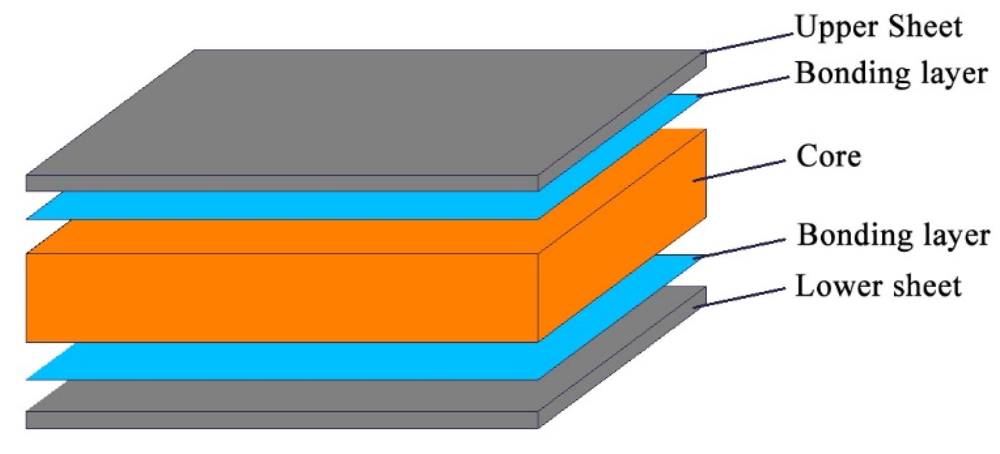
Metals, ceramics, cement, and polymers are all regularly used for man-made composites.
Basic composite material

Slide 5
Reinforcements
Reinforcements in composites as the word indicates it provides strength to the composite Its main purpose is to strengthen or increase the rate of behaviour.
It distributes the loads evenly between the core material, such that entire core material is subjected to same amount of strain.
Improves overall impact and fracture resistance of the composite.
Holds the core material together and keep them aligned in a predetermined manner.
Provides shape and form to the composite.
Protects core from environmental attack.

Slide 6
Reinforcements can be divided into:
1. Polymer: Glass fiber
Kevlar(Aramid)
Carbon (Graphite)
Boron
2. Metal: Magnesium
Titanium
Aluminium
3. Ceramic: Silicon carbide
Aluminium oxide
Zirconium oxide

Slide 7
Core
Carries load along the length of the fibre to provide strength and stiffness to the composite.
Provides heat resistance, resistance to corrosion and rigidity to the composite.
Helps in deflecting the crack front in reinforcement thereby restricting crack growth.

Slide 8
Core can be divided into:
1.Fibre: Glass fiber
Carbon fiber
TPU
Kevlar (Aramid)
2. Particulate: Gravel
3. Laminates: Plywood
Honeycomb

Slide 9
Adhesive Components
Used to assembly the composite.
Acts as interface between reinforcement and core structure.
Different forms such as liquids, paste and films.
Designed to provide the highest mechanical strength and peerless performance even upon exposure to extreme conditions.
It is important to fixture the parts while the adhesive sets up to ensure good contact between the adhesive and the layers.
The reinforcement transfers the load to the core via this interface.
A strong interface is required to produce a high strength composite. This is achieved when the bond between reinforcement and core is strong.

Slide 10
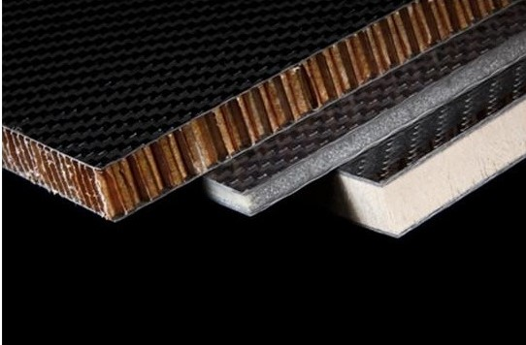
Sandwich Panels
Consists of two thin laminate outer skin and a relatively thick core is sandwiched between them.
Sandwich panels have good acoustic damping properties, high-specific strength and stiffness.
Reinforcements such as aramid, carbon fiber and aluminium are used.
Core materials such as honeycomb structure, thermoplastic polyurethane and polyisocyanurate foams are used.

Slide 11
Material Selection
Fibers determine the overall mechanical properties of the structure, while the resin determines the overall physical properties of the structure.
The resin matrix transfers the applied forces to the embedded high-strength fibers, helps the part resist the formation and propagation of cracks.
Stiffness or strength requirements determine whether the selected material should be used.
Selected based on weight, mechanical properties, ease of fabrication, design targets and cost.

Slide 12
Material Analysis
Property | Carbon | Kevlar | S-Glass | E-Glass
Tensile Strength (Mpa) | 500- 3440 | 473-3260 | 575-3970 | 330-2274
Elongation to break (%) | 1.4 | 2.5 | 5.3 | 4.8
Density (kg/cm3) | 1.8 | 1.45 | 2.43 | 2.54
Impact Strength | Good | Excellent | V. Good | Fair
Stiffness | Excellent | Good | Fair | Fair
Toughness | Fair | Good | Excellent | V. Good
Cost | Moderate | High | Fair | Fair

Slide 13
Fabrication
Produced by controlled stabilization, carbonization and graphitization of carbon rich organic precursors like polyacrylonitrile (PAN).
Steps involved in fabrication process are:
1. Stabilization:
* Precursor fibre is stretches to about 5-10 times their original length.
* Heated to about 200 - 300 C.
2. Carbonization:
* Precursor fibre is heated in the range of 1000 - 1500 C in the presence of an inert atmosphere.

Slide 14
* Carbon fibers are subjected to surface treatment to provide adequate wettability to form strong and durable bond.
* If modulus of elasticity is to be made higher, then the fiber should undergo additional process called graphitization.
3. Graphitization:
* After carbonization the carbon fibers are further heated to about 2000-3000 C.
* At the end of this process the fibers are given surface treatments which aids in subsequent production of composite.

Slide 15
TPU Material
TPU material is a group of thermoplastic elastomers with good elasticity, resistance to stresses, extremely flexible and smooth to the touch.
It is referred to as the bridge between rubbers and plastics.
It is a block copolymer consisting of alternating sequences of hard and soft segments and are formed by the reaction of
(1) diisocyanates with short-chain diols
(2) diisocyanates with long-chain diols

Slide 16
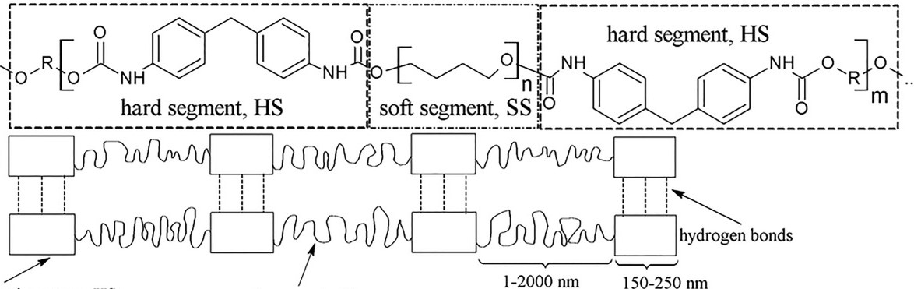
Hard Segment (HS)
Soft Segment (SS)
Schematic structure the hard and soft segments

Slide 17

3D Printed TPU
TPU can be 3D printed with several technologies to achieve specific properties.
Being flexible, TPU material can cause some difficulties while printing, including jamming, clogging the nozzle and deformation.
with good calibration and settings, it opens the doors to a large variety of possibilities.

Slide 18
Why Hexagon is used?
Hexagon is the strongest shape known.
Hexagonal patterns are prevalent in nature due to their efficiency.
It is one of the only shapes which tessellate perfectly.
The behaviour of the hexagon structures is orthotropic i.e., the panels react differently depending on the orientation of the structure.

Slide 19
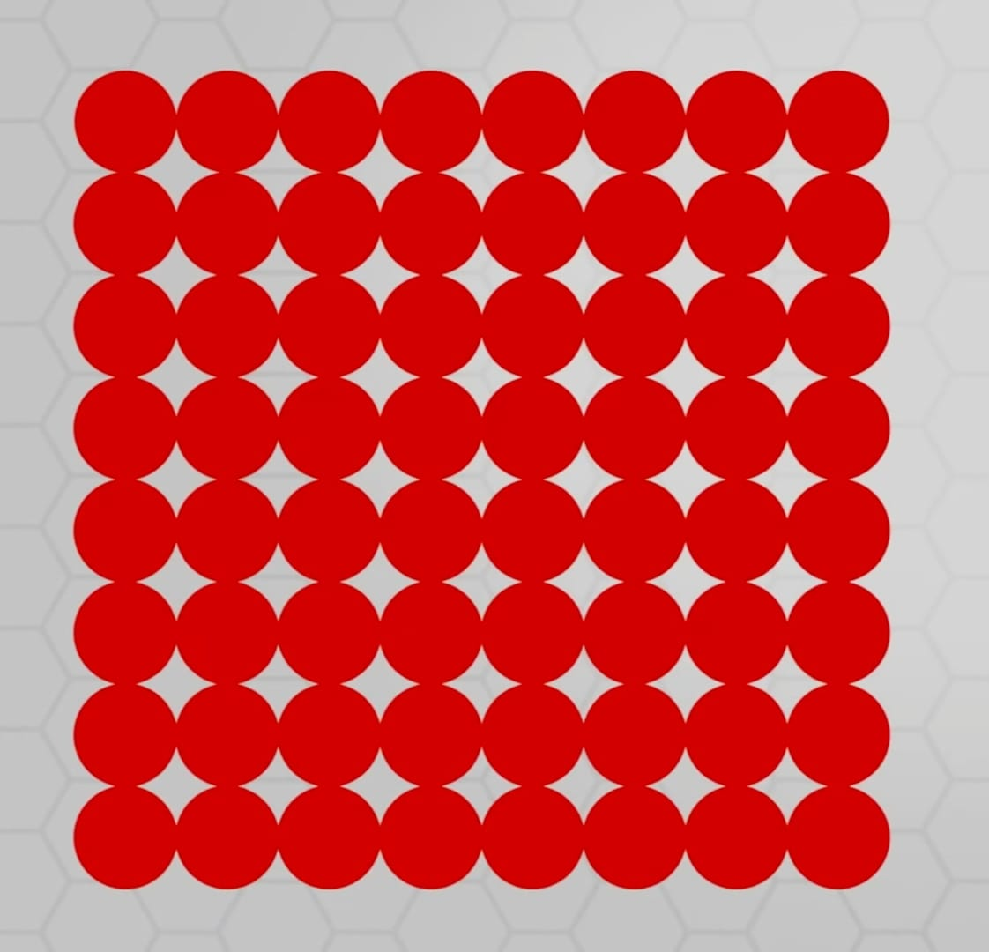
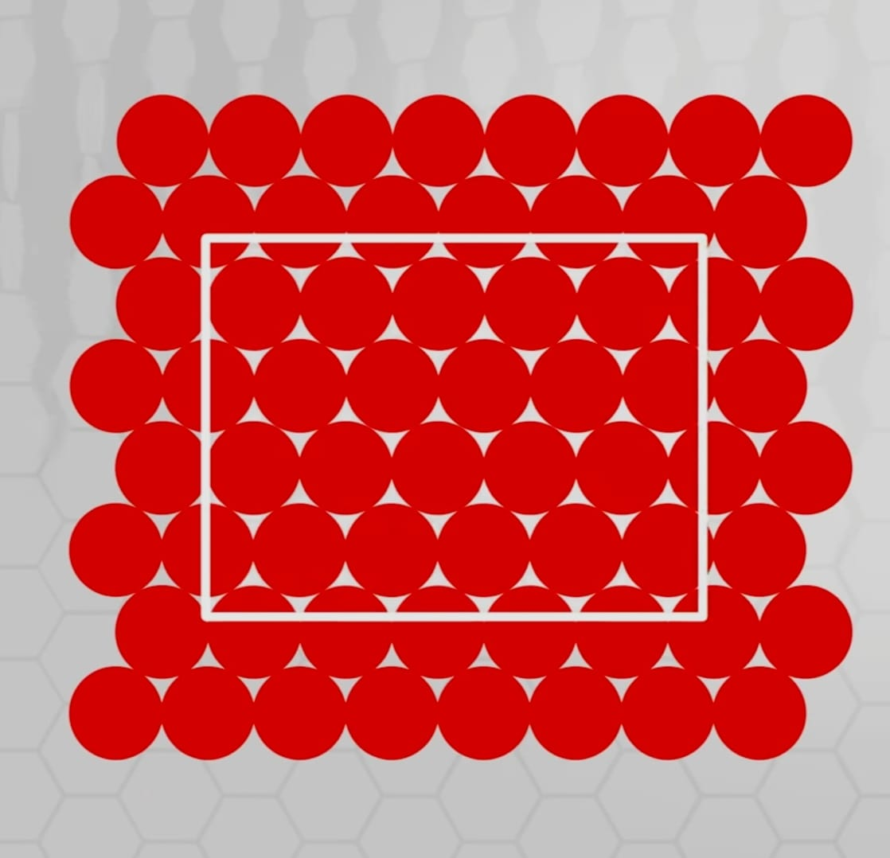
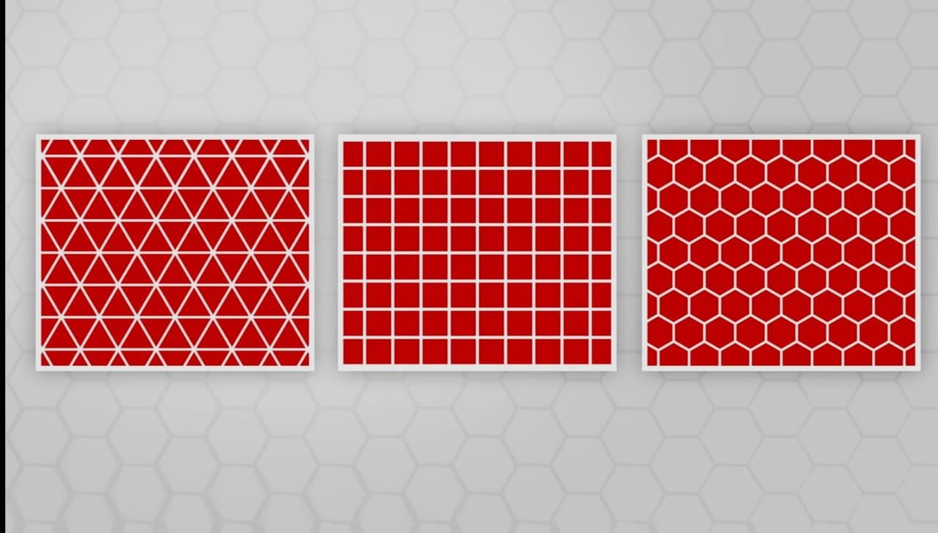

Slide 20
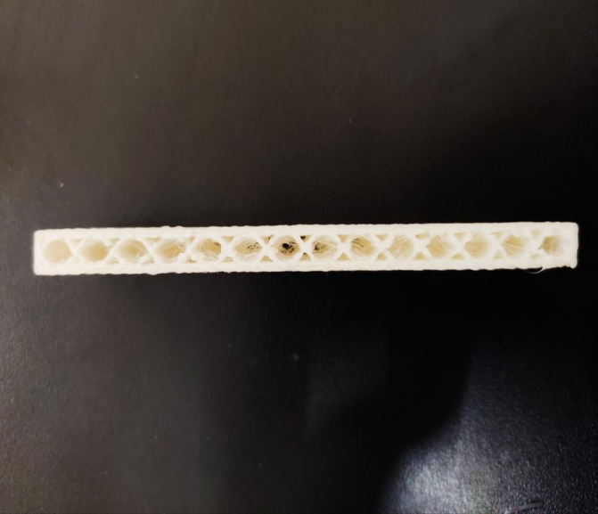
Section of TPU material

Slide 21
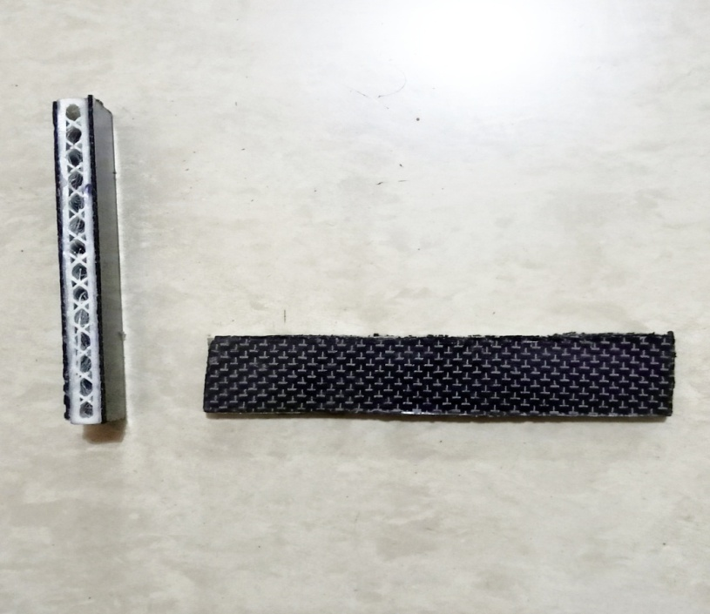
Sandwich panel

Slide 22
Tests
Flexural loading:
* Flexural testing measures the force required to bend a beam of plastic material and determines the resistance to flexing or stiffness of a material.
* Flex modulus is indicative of how much the material can flex before permanent deformation.
* Flexural tests of composite materials are useful as an alternative or supplementary method to determine tensile and compressive properties.

Slide 23
Flexural stiffness:
* The flexural stiffness is a criterion of measuring deformability.
* Flexural tests are performed primarily on composites and not fibers, unlike tensile tests.
Impact testing:
* Impact tests are used in studying the toughness of material.
* Material toughness is a factor of its ability to absorb energy during plastic deformation.
* The impact value of a material can also change with temperature.

Slide 24
In an interview, Thomas Hales—the mathematician who finally proved the conjecture—said that ultimately, “A hexagonal honeycomb is the way to fit the most area with the least perimeter.” From a bee’s perspective, that means storing more honey in a larger volume while spending less energy building a structure to contain it.
Thank you...

